Slide 1


Portfolio Creation
Name: SIDHANA SHERIN
Reg No & NMID: asbru4w2422k2145 Department: B.Sc Computer Science
College: Bharathiyar University, Gudalur

Slide 2

1. Problem Statement
2. Project Overview
3. End Users
4. Tools and Technologies
5. Portfolio Design and Layout
6. Features and Functionality
7. Results and Screenshots
8. Conclusion

Slide 3
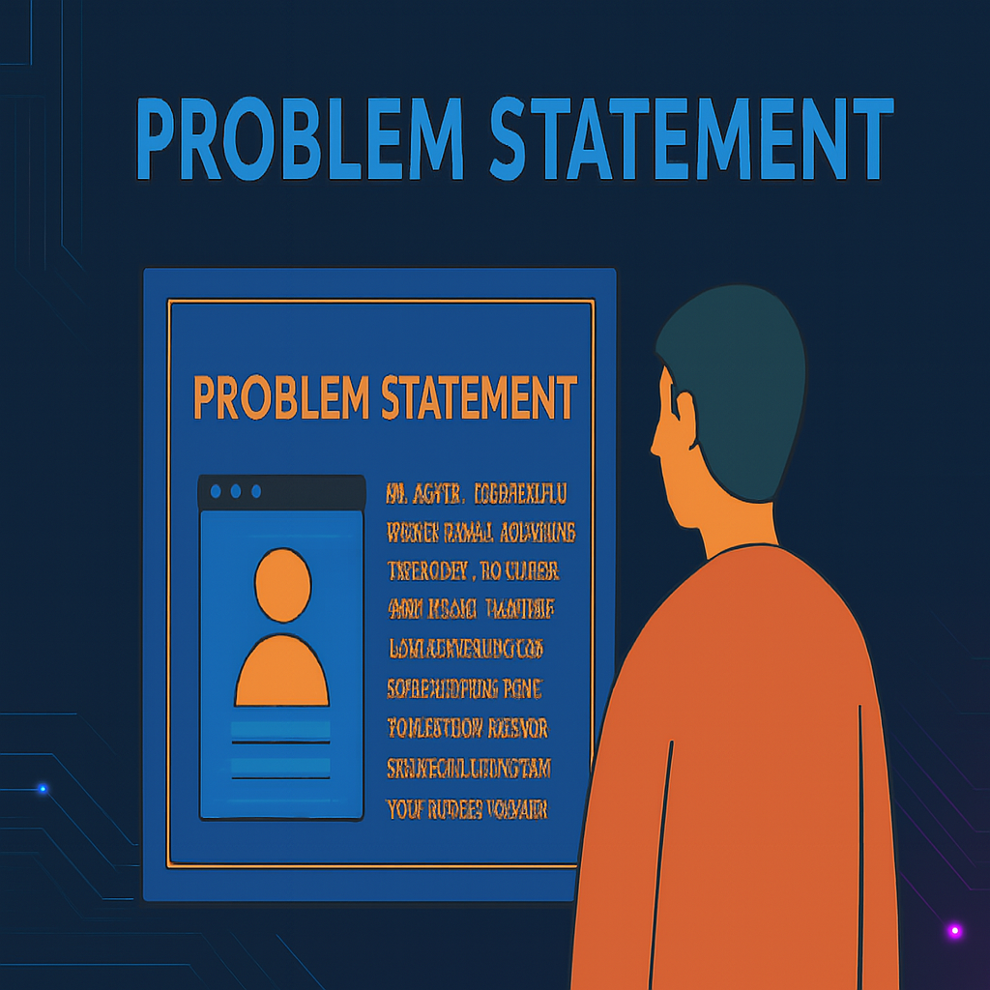
Students often lack a professional platform to showcase their skills and projects.
Without a personal portfolio, opportunities for internships, collaborations, and networking may be missed.
This project aims to solve this by creating a personal portfolio website for Sidhana Sherin with professional design, interactive features, and easy accessibility.

Slide 4

Development of a professional online portfolio website.
Highlights academic achievements, technical skills, and projects.
Includes About, Skills, Projects, and Contact sections.
Provides an elegant and responsive design.

Slide 5
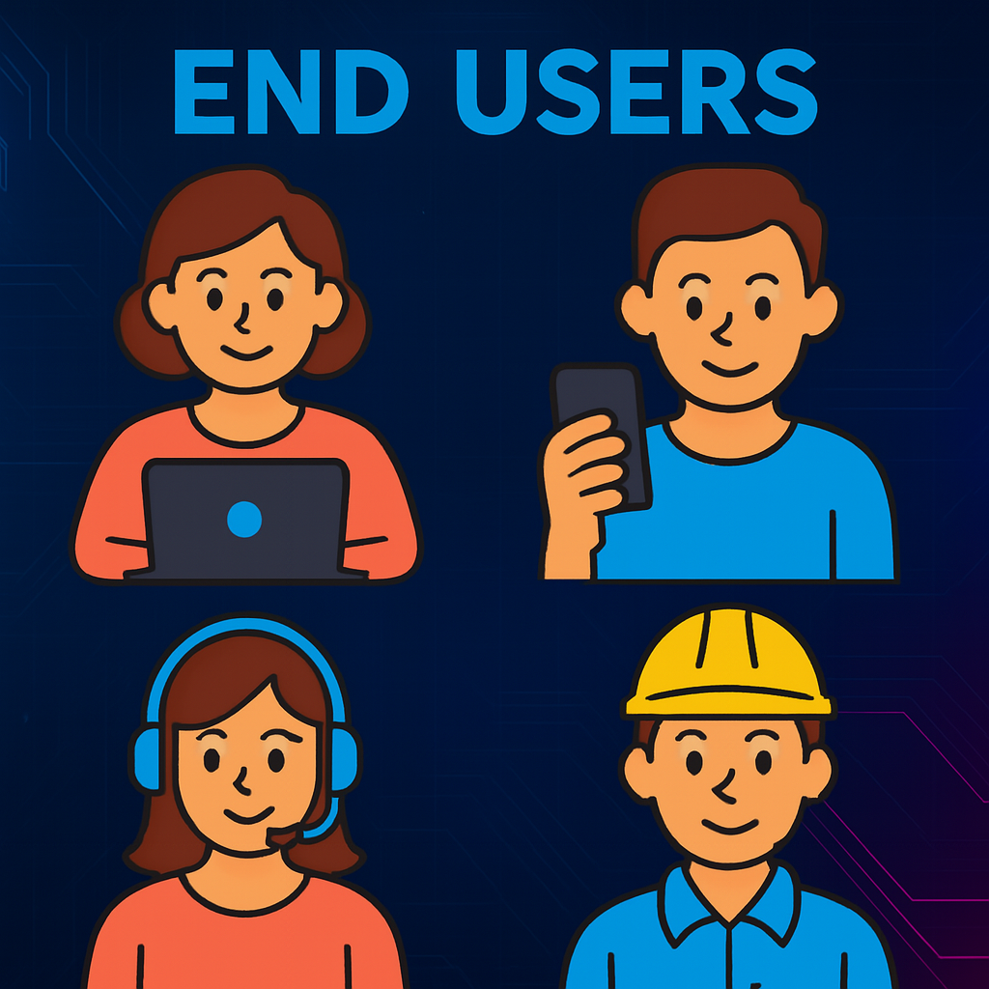
Students – To showcase their projects and skills.
Recruiters – To evaluate candidate's portfolio and skills.
Academic institutions – For project and career references.
Peers & collaborators – For networking and team projects.

Slide 6

Tools and Technologies
HTML5 – Structure and content
CSS3 – Styling and layout
JavaScript – Interactivity
GitHub – Version control
Visual Studio Code – Development environment

Slide 7

Modern, colorful, and elegant UI.
Responsive design with background images.
Sections: Home, About, Skills, Projects, Contact.
Easy navigation with interactive menu.

Slide 8

Personal introduction with background image.
Showcase of technical skills in card layout.
Projects section with descriptions.
Contact section with email, phone, and social links.
Smooth scrolling and hover animations.

Slide 9
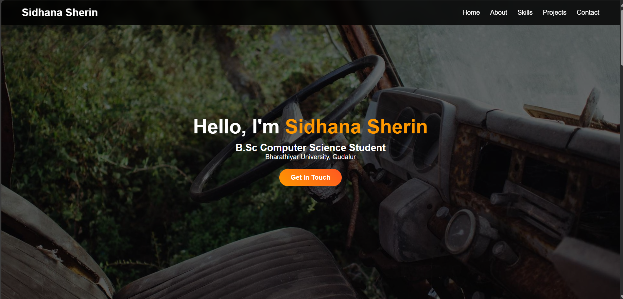
Results and Screenshots
Successfully developed a fully responsive portfolio website.
Demonstrates Sidhana Sherin’s skills and academic profile.
Screenshots of different sections can be inserted here.

Slide 10
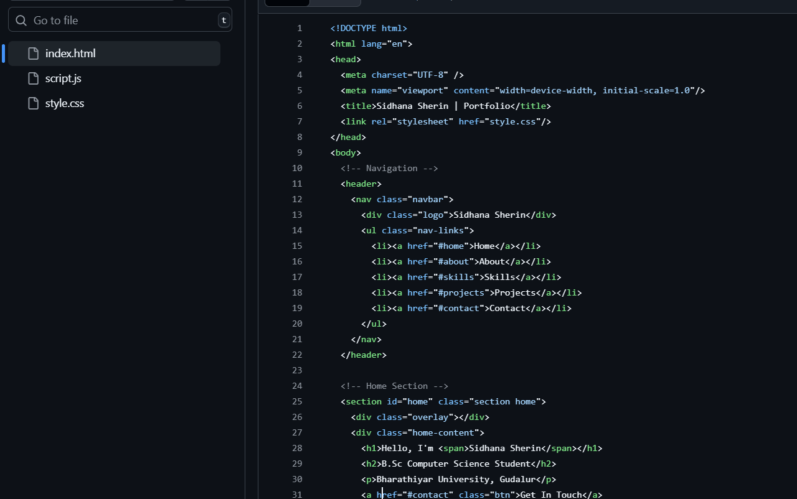
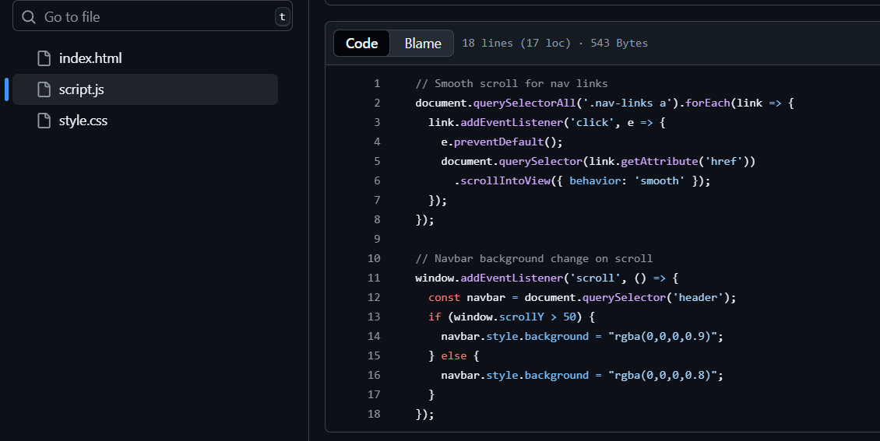
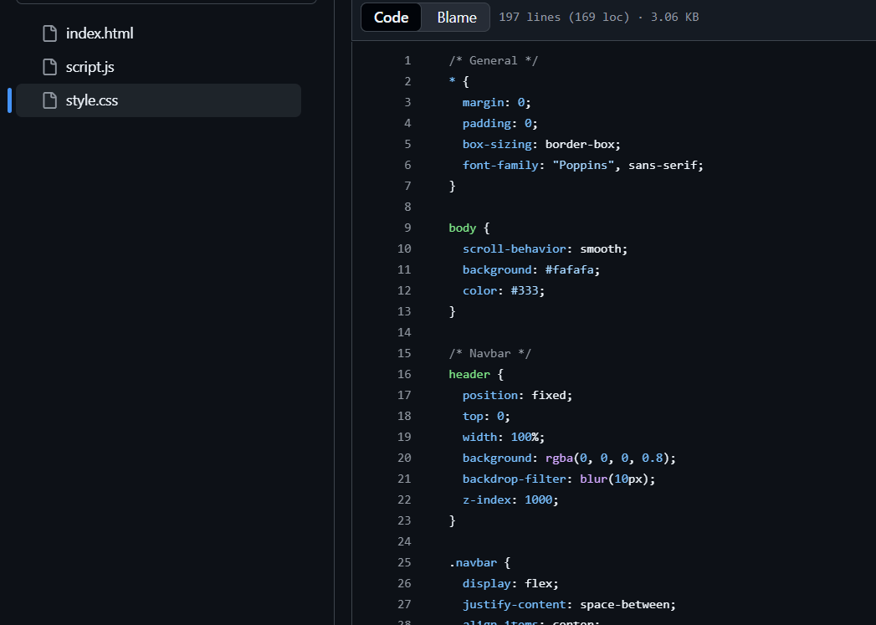
Results and Screenshots

Slide 11

Conclusion
• The portfolio project provides a professional online identity.
• Helps in career opportunities, internships, and networking.
• Demonstrates technical knowledge in web development.
• Future enhancements: Adding blogs, certificates, and live projects.

